Slide 1
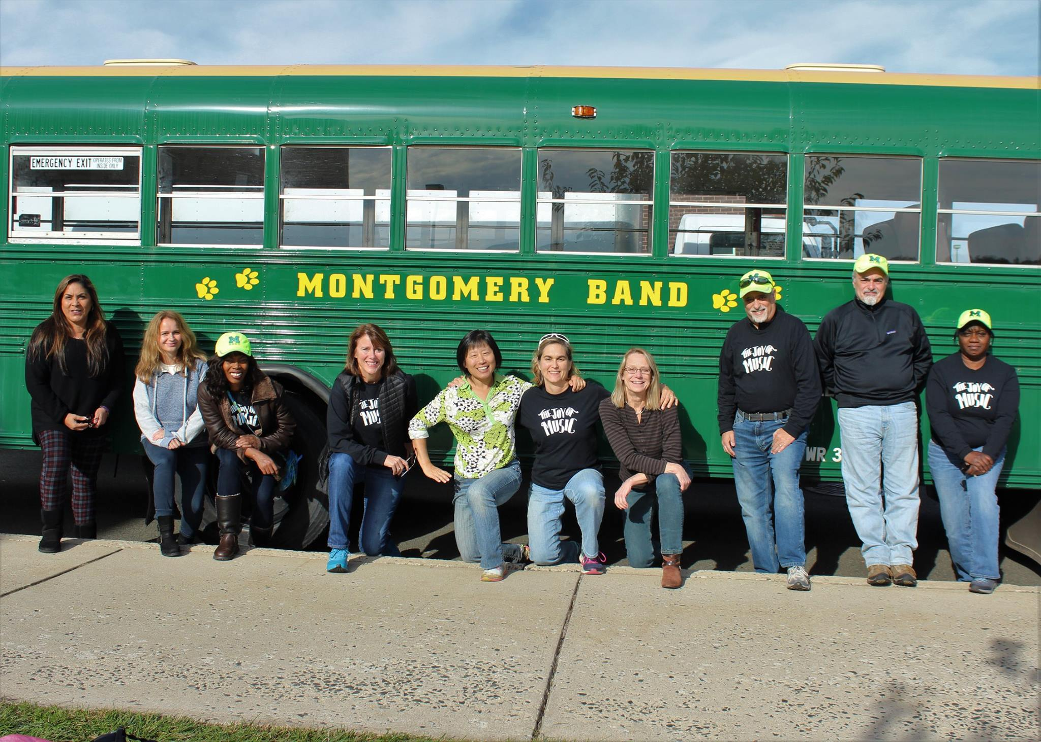
The “Pickle” Project

Slide 2
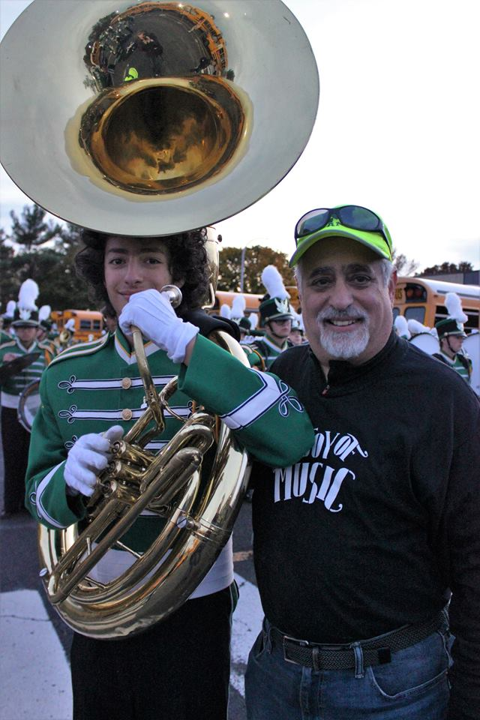
My name is Ilan Schindler. I have been in the MHS Band Program for all 4 years of high school, including 4 years in Marching Band as well.
Now I’m a senior. For my Engineering Independent Study class, I have been working on a project to benefit the band program, specifically the Marching Band.
Please read on for the details.
This is a picture of me (left) and my dad (right) at a Marching Band competition.

Slide 3
This is “The Pickle”
These are some of the Band Parents that load Marching Band instruments on to and off of The Pickle - one by one - every time the Marching Band performs away.

Slide 4
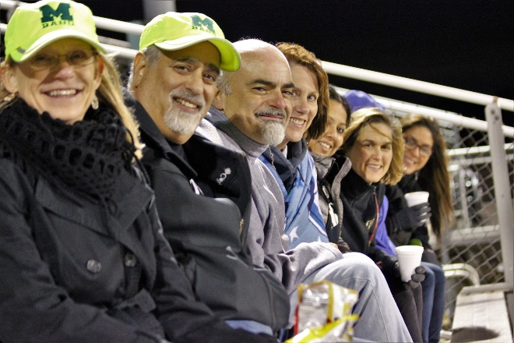


Why I’m Doing This
Give back to
Montgomery High School
MHS Band Program
MHS Marching Band Parents
Teach students to be more responsible
Visible/tangible example of engineering
Raise awareness of MHS engineering
Raise enrollment in engineering classes
To solve problems

Slide 5
Solving the Problems
Time: Current system takes a long time
Strain: Lifting the instruments is very physically taxing on parent’s legs and backs
People Power: It takes at least 2 parents in the bus and 2 parents on the ground to load the bus, and this is never enough
Consistency: Without organization, there is a general idea of how the bus gets packed from week to week, but in practice, it changes every time based on the order that instruments come into the bus
Hazardous: Many times, instruments fall out of their constraints and block the aisle, blocking the emergency exit at the back of the bus

Slide 6
The Plan
Build carts out of PVC and plywood
Carts will hold 4-8 instruments at a time and can be rolled up a ramp by the parents and secured in the Pickle
Makes students responsible for putting instruments onto the carts
Will make loading instruments faster and easier for the parents

Slide 7
How This Will Solve the Problems
Time: rolling multiple instruments on at once and quickly locking them in will be much faster than the current system
Strain: instruments will be rolled up a ramp, instead of lifted one-by-one onto the bus
People Power: fewer people will be needed to push carts up a ramp and put them into place
Consistency: each cart has a specific place where it locks in. Everything will come into the bus in the same order every time and will be put away in the same place every time.
Hazardous: the locking mechanism is more secure and instruments won’t easily fly into the middle walkway, keeping the fire escape easily accessible

Slide 8
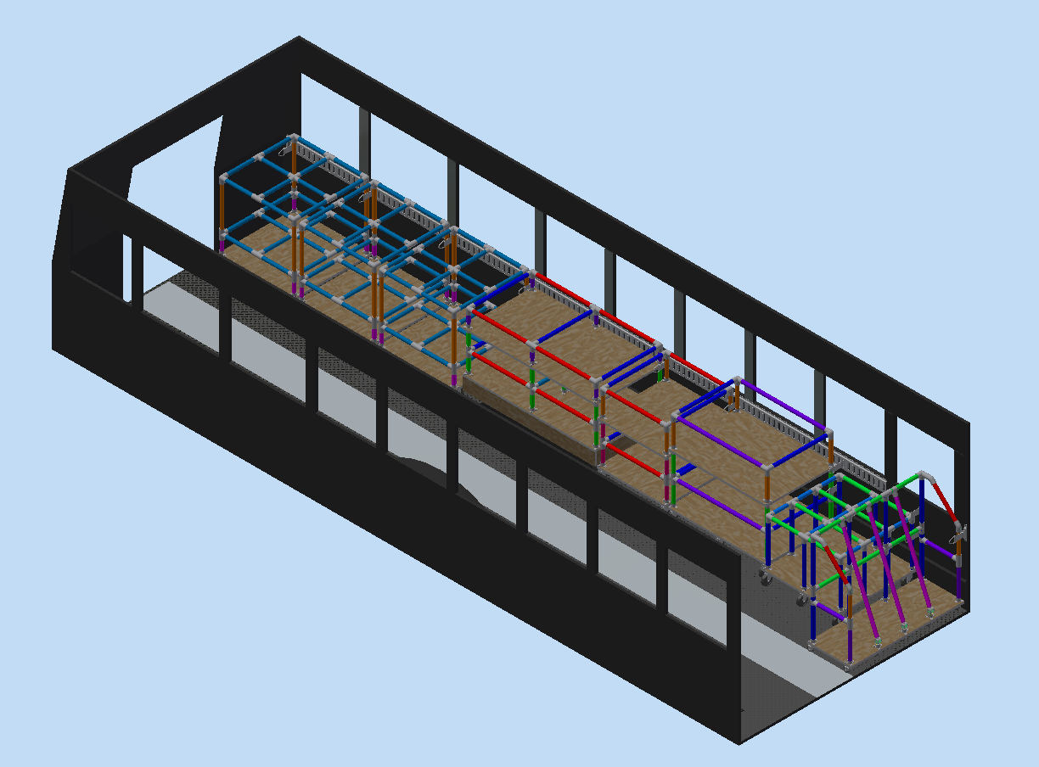
Proposal – Final Result

Slide 9
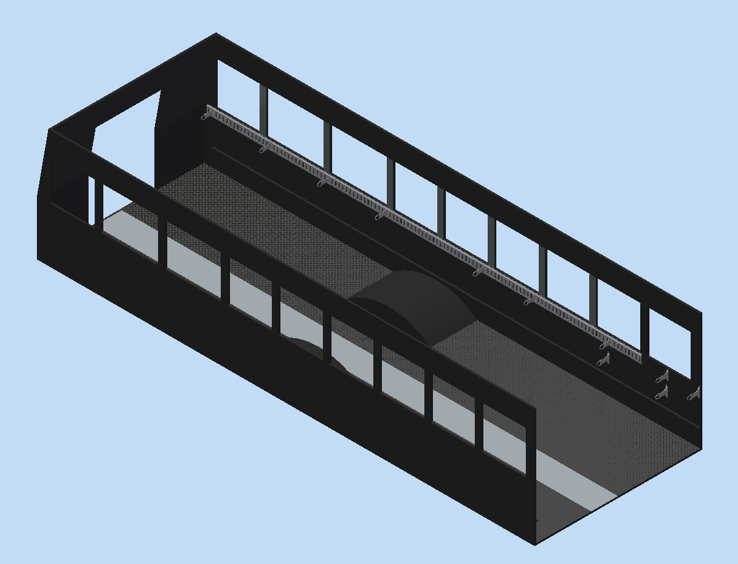
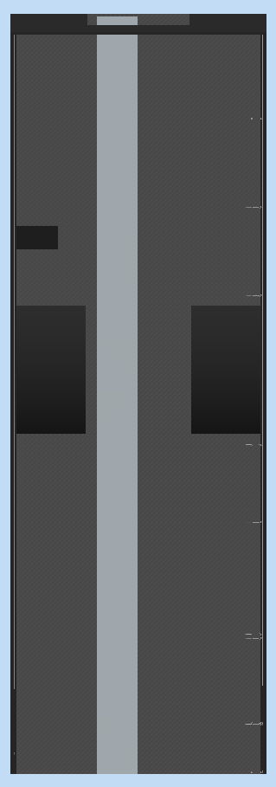
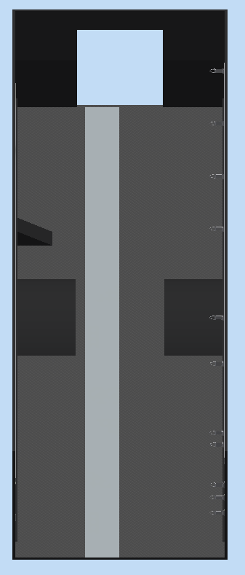
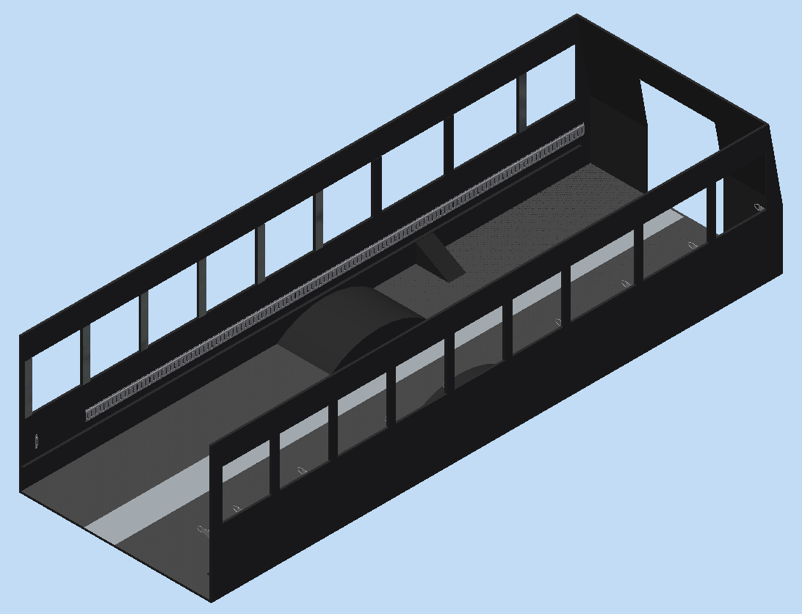
Pickle Interior
Percussion
The plywood panels here are changes that need to be made to the Pickle.
Sousaphones

Slide 10
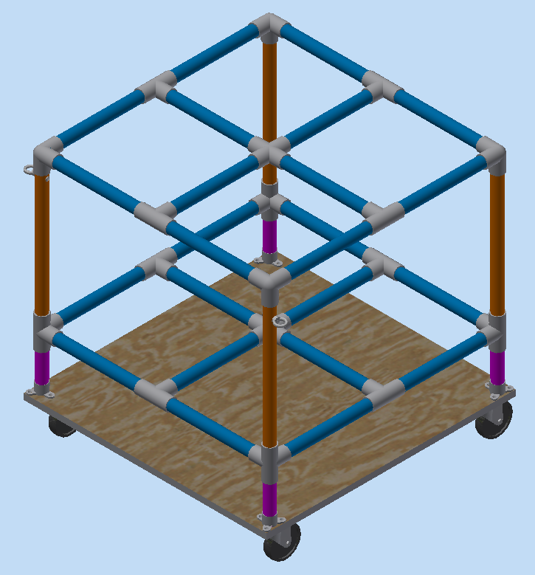
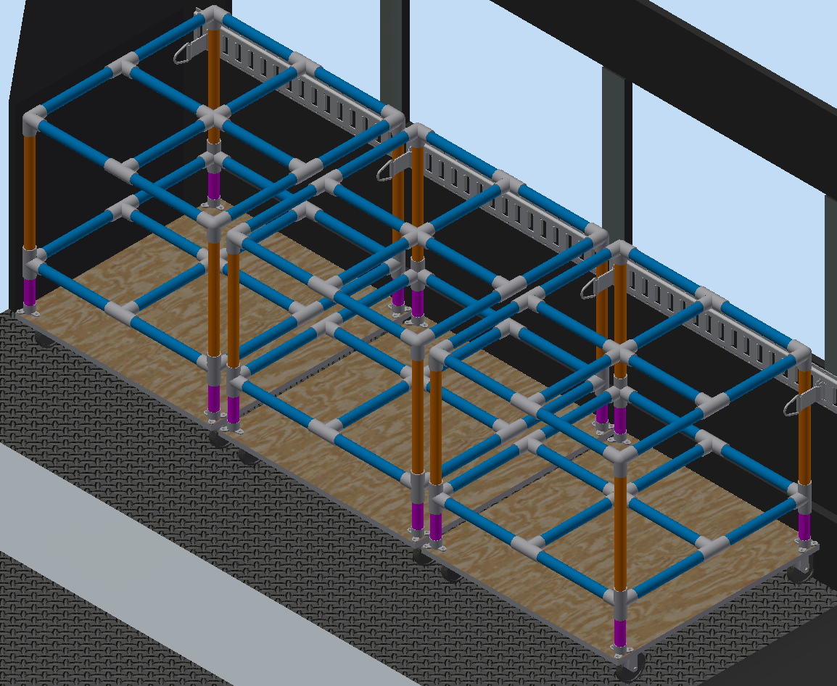
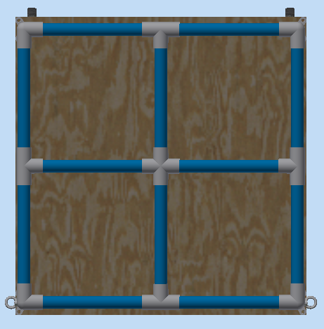
Trombone Cart

Slide 11
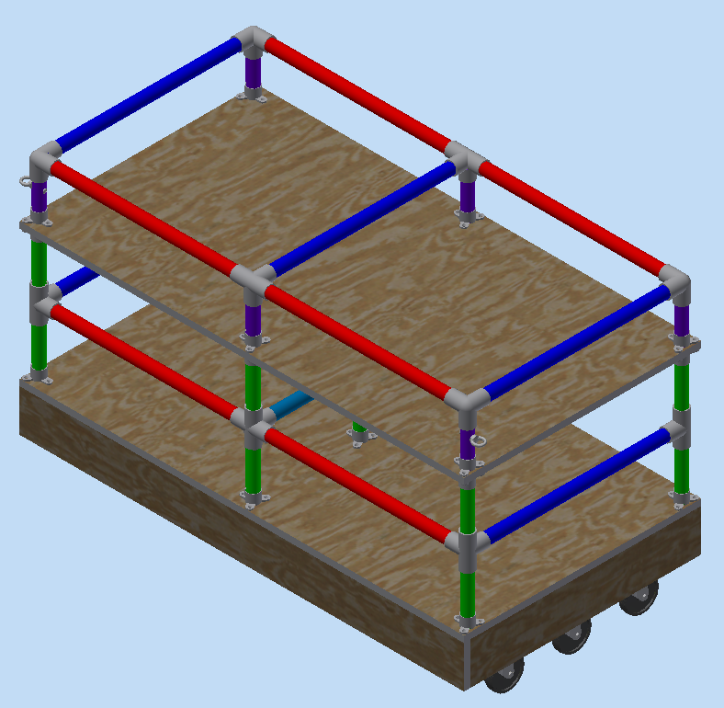
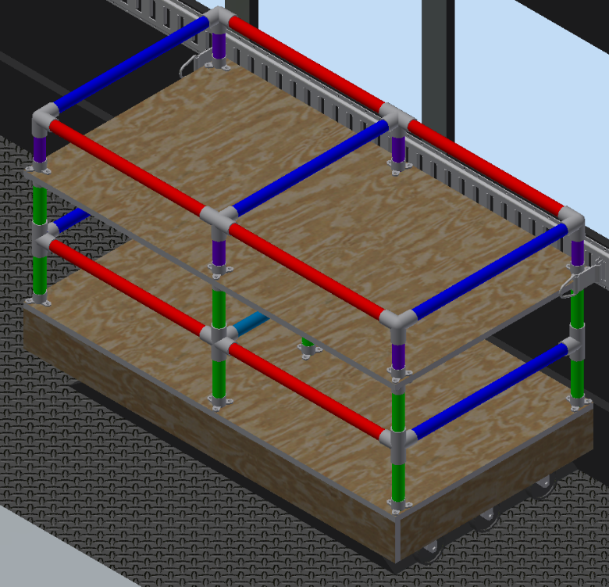
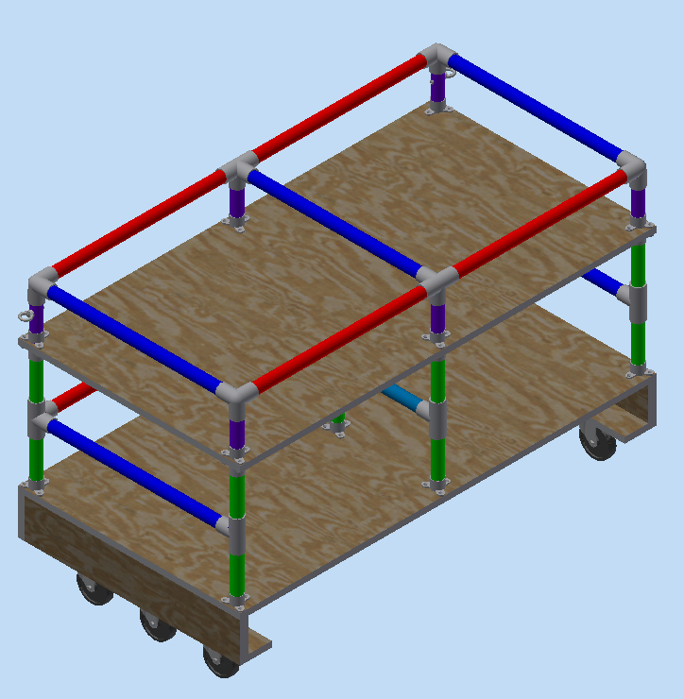
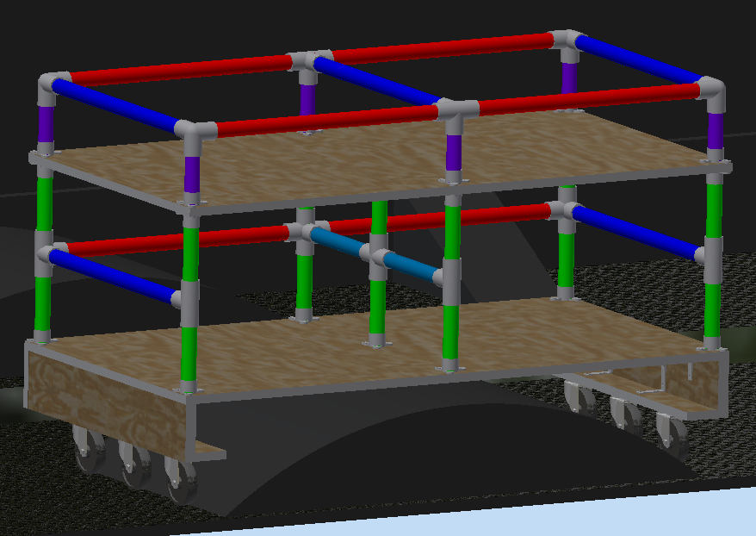
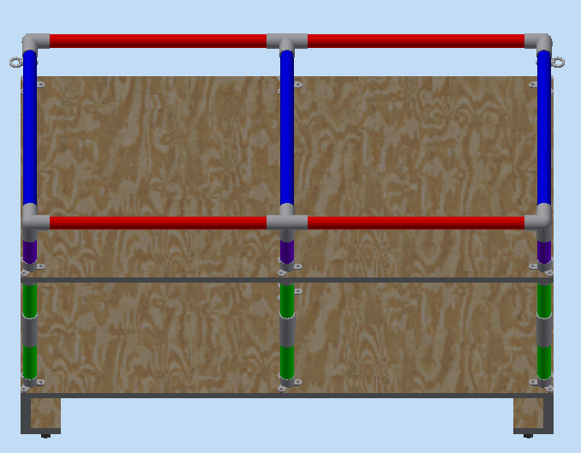
Mellophone Cart

Slide 12
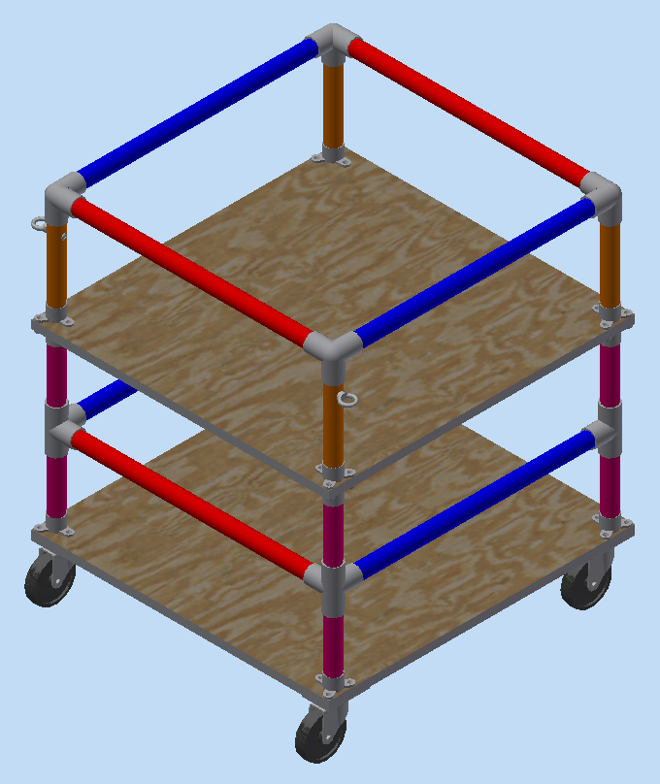
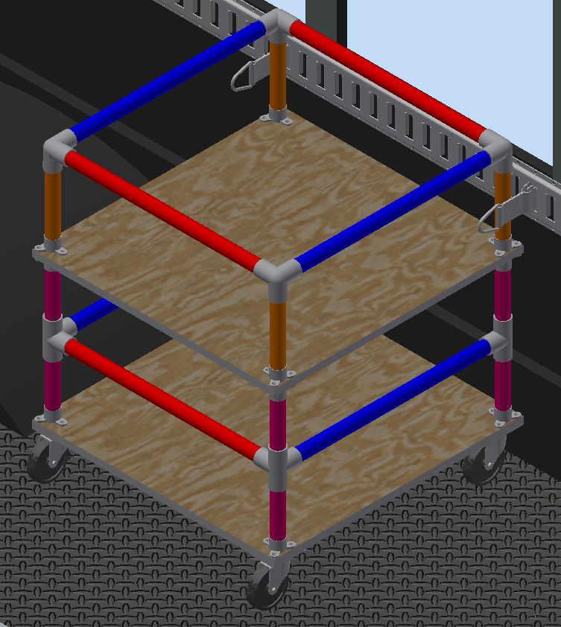
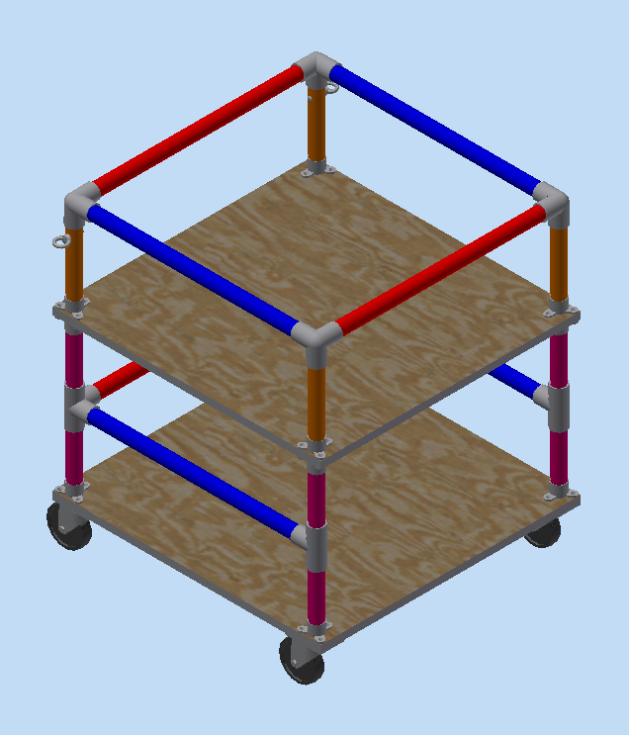
Mellophone Side Cart

Slide 13
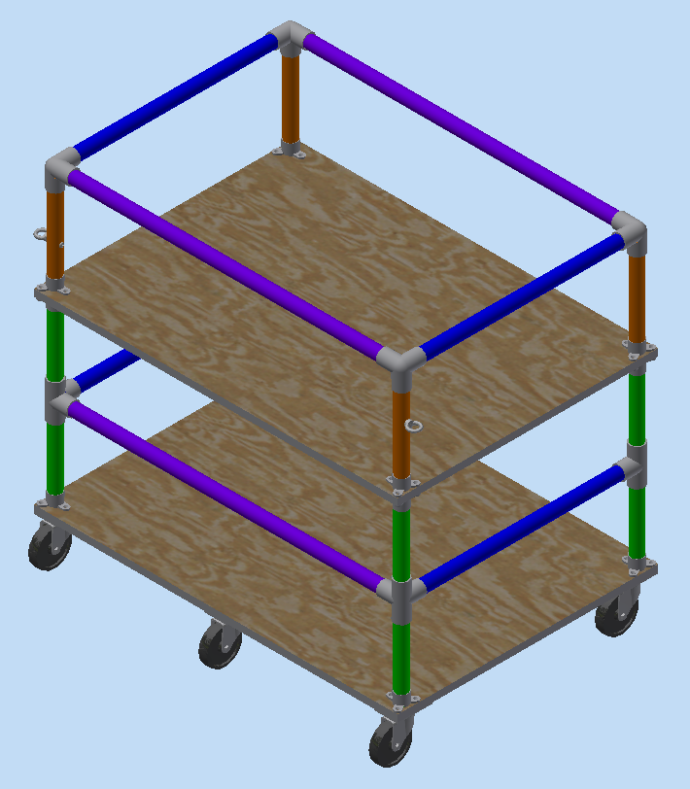
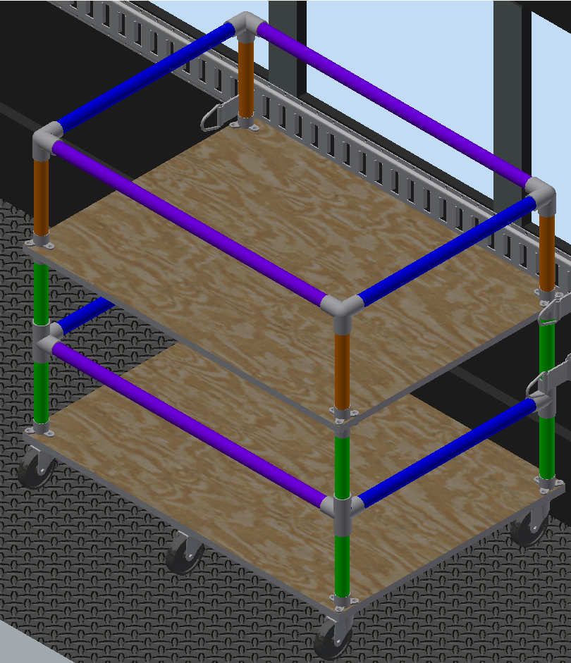
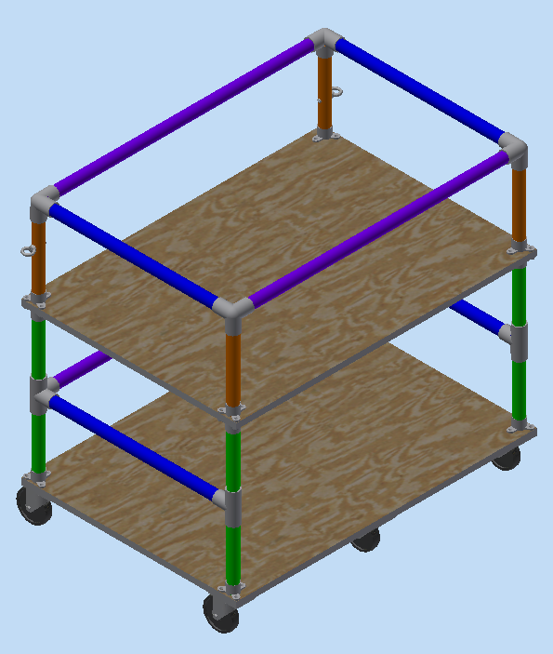
Euphonium Cart

Slide 14
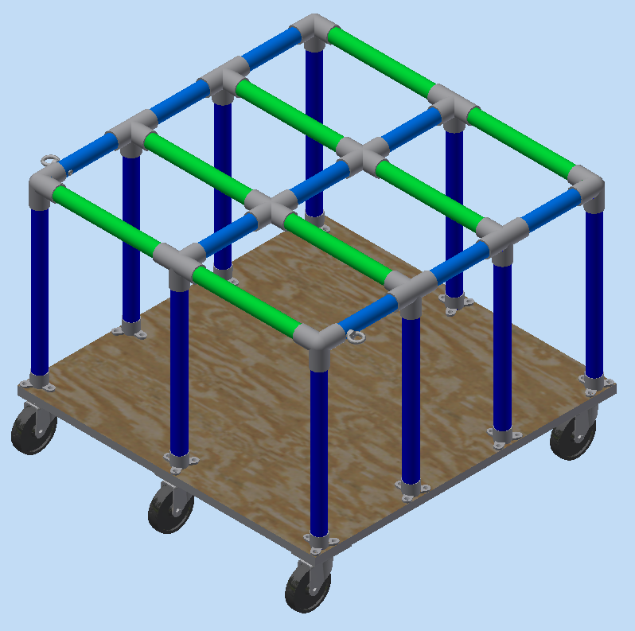
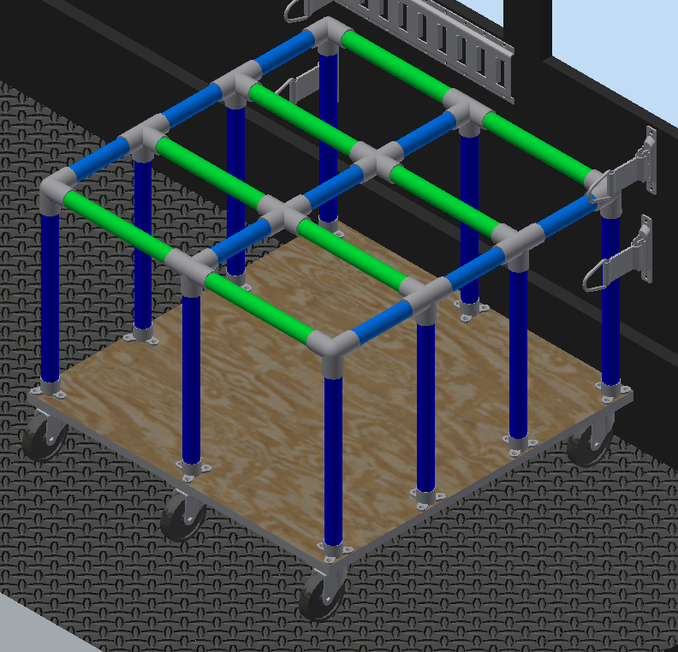
Tenor Saxophone Cart

Slide 15
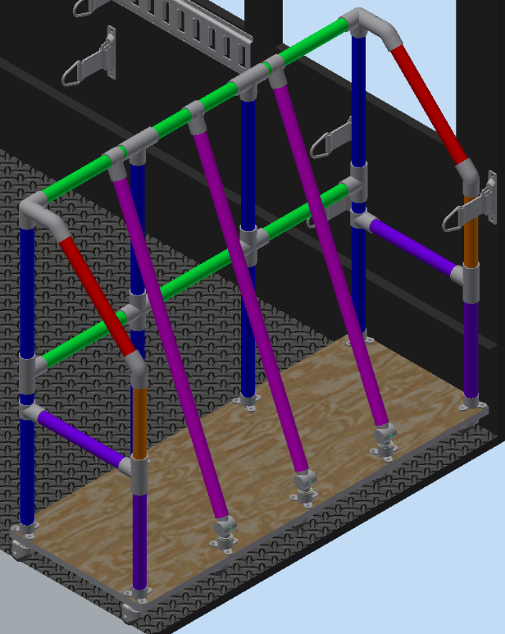
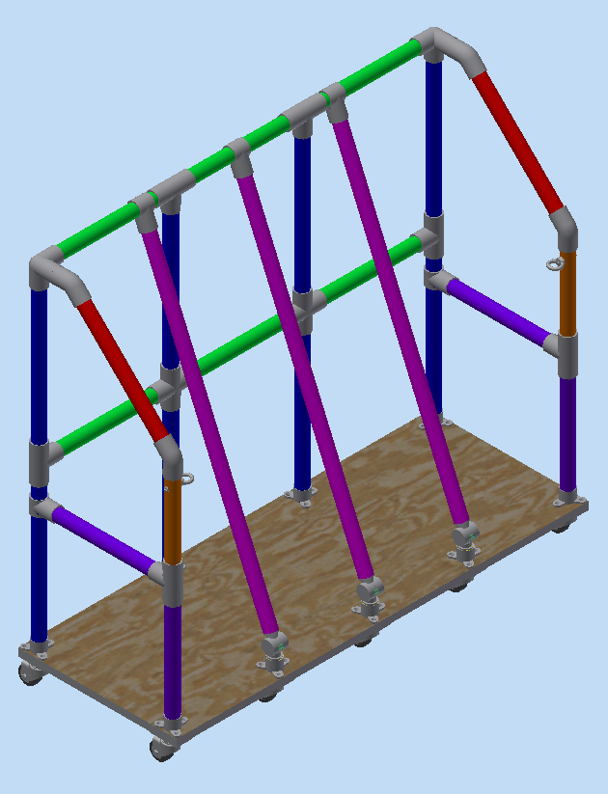
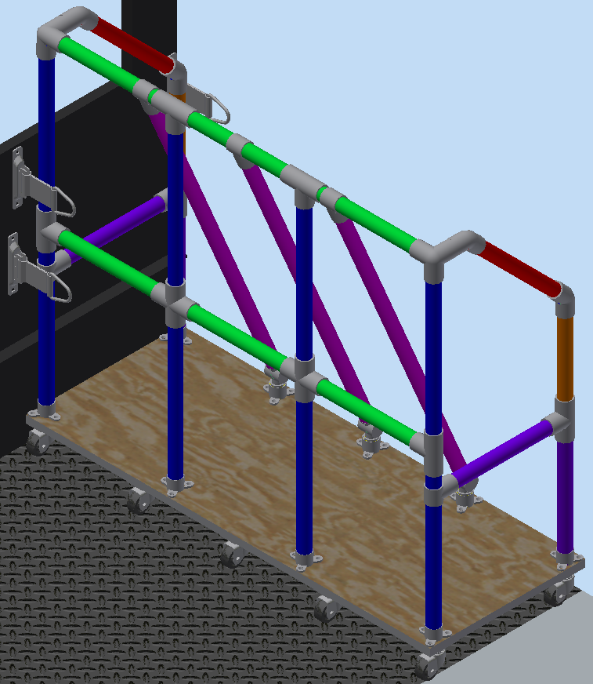
Baritone Saxophone Cart

Slide 16
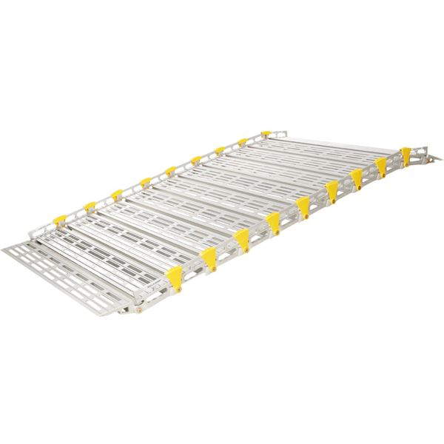
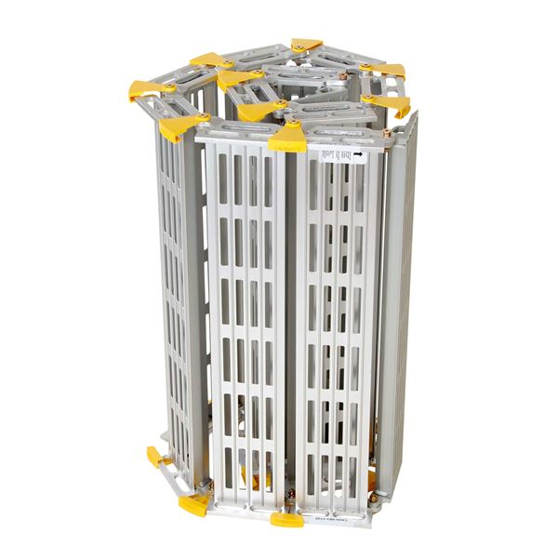
Ramp
The ramp is a Roll-A-Ramp from Roll-A-Ramp®. It will be 11ft. long.

Slide 17
Costs
The project is expected to cost $2800- $3200
Plywood: $160
PVC: $500
Wheels: $350
Other Hardware / Paint: $300
Ramp: $1400

Slide 18
Budget
There is a difference between the total cost as a sum of the costs/materials and the total cost as a sum of the costs/cart, which amounts to $42.11. This is caused by the costs/material for paint, eyebolt nuts, and wood eyebolts being higher due to A: paint not requiring a full gallon, but a full gallon still needs to be bought, so it is rounded up; B: the additional cost of a pack of 50 screws, not included in the price/item; C: the cost of pack of 50 of the item. These three additional costs are not included in the price/cart, but amount to the $42.11 difference between the two totals.

